Slide 1

Confidential
Investor Presentation
A Personal Online Knowledge Networking Service
Capture. Create. Share.
July 2011
Confidential

Slide 2
Table Of Contents
ReadOz
350 W. Ontario St. #4W
Chicago, IL 60654
Phone: +1 312 929 2500
Fax: +1 312 846 6186
Email: Info@readoz.com
Section
Pages
Investment Considerations
4
<ReadOz Business & Platform Overview
5
Need/Solution
13
Industry Overview
16
Go-to-Market Strategy
21
Stickiness Factor
26
Management Team
33
Financial Overview
34
Conclusion
39
Investment Considerations
40
3

Slide 3
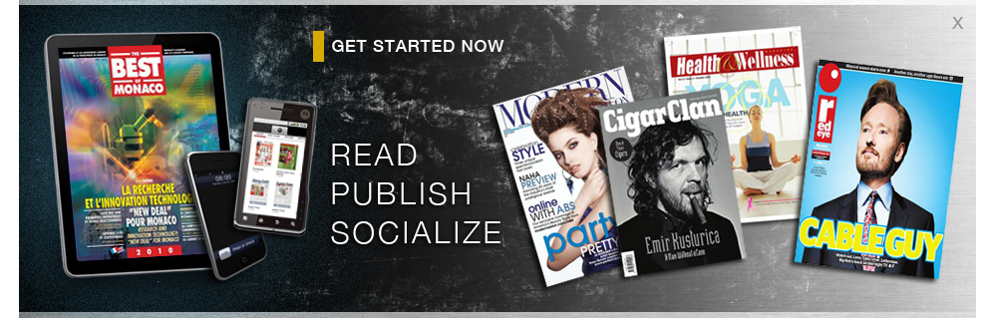
Key Investment Considerations
High Value-Add Personal Online Knowledge Networking Service
Significant Revenue Growth Opportunities
Well-Established Growth Markets
Customer Data Analytics Capabilities
Proven & Unique Management Team
Established Global Customer Base
Deep Academic-Based Advisory Board
Unrealized Additional Opportunities
Effective Pivot Strategy Formula
Successful Launch of Version 1.0
4

Slide 4
Version 1.0 – Established in Market Place (Live)
<Get Desktop Screen Shot>
ReadOz – Desktop Version 1.0
ReadOz – iPad Version 1.0
5

Slide 5
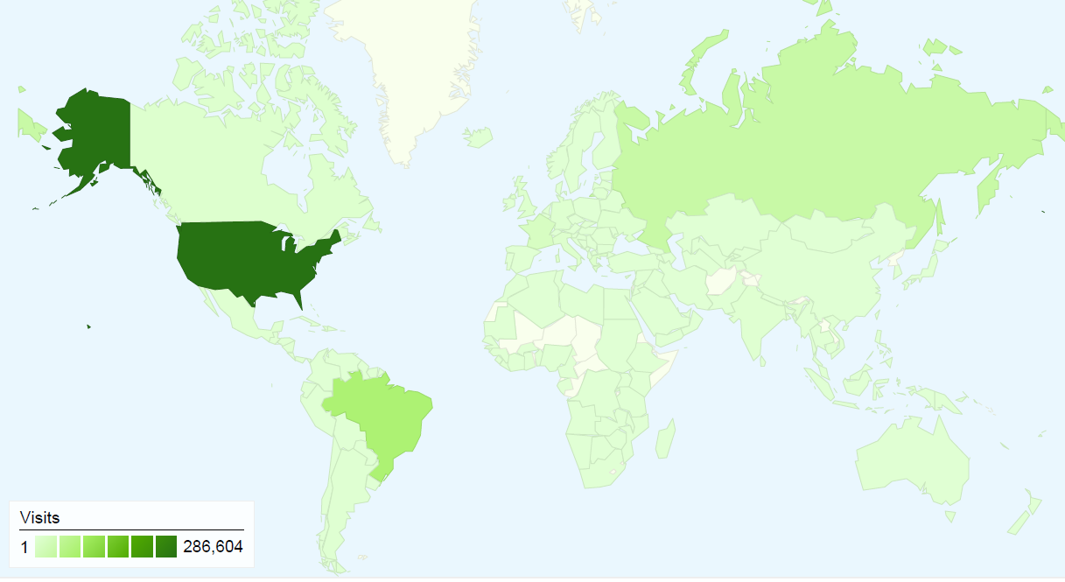
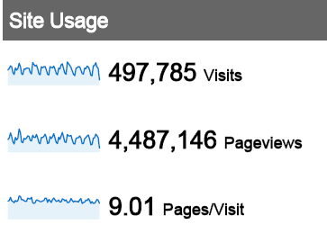
ReadOz Platform – Current Global footprint
Text from Kal, use pictures from Google Analytics
497,788 visits came from 182 countries/territories – March 1st to May 14th 2011
Source: Google Analytics
6

Slide 6
ReadOz - Quick Facts (Versions 1.0)
Already Reader Based (Current Unique readers per month approximately 120,000)
Cloud-Based Internet, Smart Phone, Tablet Application
Version 2.0 – Ready for Launch
700 Publications Registered
Current Monthly Average Revenue of $15K
Global User (Reader) Base
Proven & Motivated Management Team
60,000 Average Page Views per Day
Successful Launch of Version 1.0
Approximately 4,000 Unique Visitors Per Day
7

Slide 7
ReadOz Pivot - Future Vision
Online
Digital Publishing
Platform
Personal Online
Knowledge Networking
Service
2007 – 2011
Aug 2011 & Beyond
Version 1.0
Reader Centric
Version 2.0
Publisher
Generated
Content
User
Generated
Content
Pivot is built off the ReadOz Access to Knowledge Foundation!
8

Slide 8
ReadOz Vision, Mission & Value Proposition
Vision
Statement
(What)
To compile the world’s publicly available knowledge for efficient personal use.
To make digital information more useful and accessible for users by providing a personal online knowledge networking service where information can be captured, shared, and reused.
Mission
Statement
(How)
Knowledge (Information) Workers/Users, Publishers, & Advertisers
Audience
(Who)
Work Smarter – Do More!
Value
Proposition
(Why)
9

Slide 9
ReadOz - Business Overview
What We
Do:
ReadOz.com offers an online knowledge networking and management service and tools that address specific needs of user (readers), publishers, and advertisers.
Key Pains:
Information Related Problems: Can’t EASILY Find, Access, Share, Update, Track, Improve, Store personally relevant information from the internet.
Version 1.0: Originally launched in June 2007 as a digital publishing platform with currently over 700 publications established, 3.9K unique daily visitors, and 60K average page views per day. - More than 50% unique visits every month!
Top Countries utilizing ReadOz: U.S. Brazil, Russia, France, Greece, Italy, United Kingdom, Canada, Germany, Ukraine
Current State:
10

Slide 10
ReadOz Identified - Pain in the Industry
“I know I have a document on that … somewhere. Is there a newer version?” “I have to dig through 54 different places to put together the answer.” “The department head sent an e-mail on that? Really? My inbox is out of control.”
“Nine out of ten U.S. professionals say they need to search for old e-mail or documents at least once a week. Not being able to access the right information at the right time is a huge waste of time.”
“On average, 59% of professionals surveyed say that the amount of information they process at work has significantly increased since the economic downturn.”
“On average, workers report spending slightly more than half of the work day receiving and managing information, rather than actually using information to do their jobs. Plus professionals estimated that between one third and one half of all information receive daily is not important for getting their jobs done.”
Source: LexusNexus 2010 International Work Productivity Study
Note: The LexisNexis 2010 International Workplace Productivity Study covered 1,700 white-collar workers in five countries—the United States, China, South Africa, United Kingdom and Australia. Professionals in every nation said they were struggling to cope and looking to their employers for customized solutions.
11

Slide 11
ReadOz Evolution – Formulation of Solution
“Information overload is now in overdrive!”
Source: LexusNexus 2010 International Work Productivity Study
Theme
Company
Year
“The Tool”
Solution
Find
Google
1998
Search Engine
Organizing
“Find Information”
Connect
Facebook
2004
Social Network
Connecting
“Connect to People with Information”
Personal
Knowledge
Network
Compile
ReadOz
2011
Compiling
“Access & Utilization of RELEVANT & USEFUL Information!”
12

Slide 12
Current Market Problem – Addressable Needs
ReadOz
Solution
Next Slide
13

Slide 13
Market Solution – A Personal Online Knowledge Networking Service
14

Slide 14
ReadOz Version 2.0 – Service Components
Each Component adds up to provide a COMPREHENSIVE solution!
15

Slide 15
Addressable Market – How BIG is the Pain!
Internet Savvy
Student
14M – U.S. University
Level Students
Source: WorldBank
Avid Online
Periodic Subscriber
56M U.S. Daily Newspaper
Subscriptions
Source: ReadOz Management
Career-Oriented
Knowledge Worker
36 – 80M in U.S.
Source: Dept. of Labor
North America
Magazine Publishers
20,628
Source: MediaIDEAS
16

Slide 16
Industry & Markets – Market Growth Opportunities
Periodical Industry – Print to Digital Content Transition 2007H – 2020P
U.S. eReader Content Market
– 2010 – 2020P
Magazine Content Sold on/for Tablets
2010 – 2020P Worldwide
Online Advertising
2000A – 2020P
CAGR – 15%
17

Slide 17
Market Competition
Current competition does not offer COMPREHENSIVE solution!
18

Slide 18









Direct & Indirect Competitors – McKinsey 9-Box Matrix
Opportunity
to jump
competition!
High
Medium
Industry Attractiveness
Low
Low
Medium
High
Ability to Compete
19

Slide 19
Sustainable Competitive Advantage vs. Competition
Proprietary Algorithms – Top features include: Capture & Auto Update Functions
ReadOz Brand – Read + Oz equals the Land of Oz
“Where anything is possible!”
Global Platform – Universal Application
(Multi-lingua capabilities)
Comprehensive Reader + User Publisher Scalable Platform
+ Self-Service Advertising Upload = All-in-One Solution
Underlying User (Reader) Database – Publisher Portal Data Analytics
Appreciating Marginal Value – Each Document added provides additional support to ReadOz Value Proposition
20

Slide 20
High-Level Milestones Overview
User Acquisition
Sales & Marketing
One Million Users – Month 15
Two Million Users – Month 20
Three Million Users – Month 22
Four Million Users – Month 24
Hiring of first sales Person – Month 1 – Year 1
Hiring of second sales Person – Month 7 – Year 2
Hiring of Ad Sales person – Month 7 – Year 1
Hiring of Ad agency – Month 6 – Year 1
Note: Management conservative estimates
Financials
Operations
One Million in Revenue – Year 2 - Month 6
Cash flow Positive – 1Q - Year 3
Profitable – Month 1Q - Year 3
Pilot Launch – Month 6 – Year 1
Search for Seasoned CEO – Month 3 - Year 1
Hiring of CEO – Month 6 to 9 – Year 1
Note: Management conservative estimates
21

Slide 21
Strategic Plan - Milestones – Year 1 & 2
22

Slide 22
ReadOz Multi-Level Value Proposition
Start
Finish
Register
Upload/
Store
Publish
Tag/
Store
Share
Retrieve
Monitor
Refer
23

Slide 23
User Adoption Lifecycle – Proactive/Referrals/Incentives
Step 1
Step 2
Step 3
Get Users
To
Website
Registration
&
Download
Continued
Usage
1. Publishers signed up
1. Direct Messaging to target audience
1. Incentive programs
2.. Strategic Partners
(Education Networks)
(web properties)
2.. Ease of navigation – limited no. of clicks
2.. Critical information downloads
3. Social Email & referral campaigns
3. Sharing of information between users
3. PR – Publicity (Article)
4. Incentive programs
4. Special publication push to users
4. Social Media (FaceBook, twitter, podcasts)
5. Social Email & & referral programs
5. Event marketing, pod casts (campus presentation)
6. Word of mouth referrals
Note: Avoveformentioend sales & marketing approaches are first half-year pilot phase.
24

Slide 24
ReadOz Key Features – Version 2
Read
Publish
Search
Read
Publish
Search
Access to READ public and private info. on network
eBooks, PDFs, etc.
Ability to PUBLISH public information and private group documents for review by other users.
Ability to SEARCH network by key words to find info in public and private ReadOz networks
share
Track
Track
Share
Track
Capture
Capture
Ability to SHARE info between users and groups
Ability to TRACK uploaded information and share information to other users.
Ability to easily CAPTURE info. From web and publish in ReadOz Network for viewing
Write
store
Update
Store
Update
Automatic UPDATE feature provides most recent edition of document.
Highlight documents, WRITE notes on documents for other users to review.
Easily STORE info on network with limited steps.
25

Slide 25
User “Stickiness” Factor
Step 1
Step 2
Step 3
Registration
Download
Data
Capture
Key Event:
An initial critical (make or break) event in user adoption is getting the user to register on the ReadOz website.
ReadOz Solution:
Incentize with special offers including free unlimited data storage, email accounts, etc.
Key Event:
The downloading of the ReadOz platform is essential to user utilization of all ReadOz features and tools.
ReadOz Solution:
Prompt user to download immediately after registration and offer incentives to go through steps.
Key Event:
A secondary critical (make or break) event in user adoption after registration and downloading is the usage of the data CAPTURE tool. The user’s ability to see the strong value of this tool is essential!
ReadOz Solution:
Provide short demo to show ease of data capture..
26

Slide 26
“Stickiness” Factor Summary
Word of Mouth is driven by the need to share.
Free unlimited storage further enhances the chances of repeated sharing with new users unlike the limitation of capped free storage by competitors (i.e DropBox).
Capture and data sync triggers page views
Sharing fuels word of mouth or referrals
Synch to email box provides connector which allows for email updates and incentives to be directed towards user.
Proven Semi-Sticky already, just needs steroids (capital) to push Company towards success!
27

Slide 27
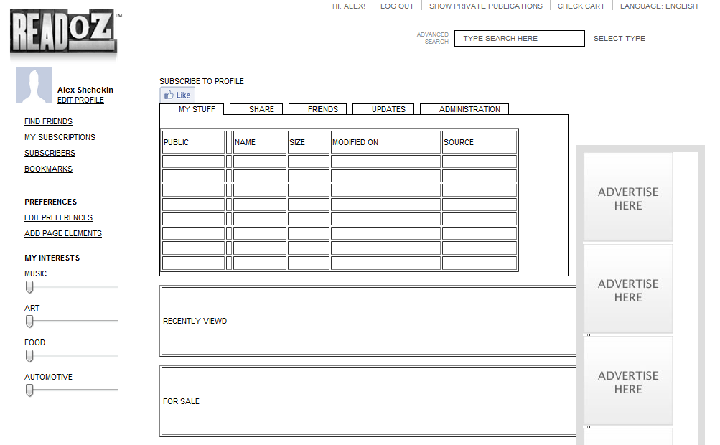
ReadOz Version 2.0 wire-Frame Screen Shot
Multiple
Knowledge
Toolbar &
Features
Document
Search
Function
High-Level
Navigation
Bar
Vertical
Advertising
Space
Interest
Categories
Documents
Created by Author for Sale
Document Recent - Viewing
History
28

Slide 28
Key Metrics – Desire to Understand End User/Service/Info.
Number of visits
Countries
Cost per user acquired
Cost per user serviced
Revenue per user
Viral coefficient
Number of published documents
Number of public documents
Number of private documents
Number of pages viewed
Number of visits per month
Length of visits
Number of new registrations from each source
Number of downloads from each source
Number of searches
Type of searches
Number of subscriptions purchased
Dollar amount of subscriptions
Number of ad spaces
Number ad spaces by type
(premium and non-premium)
Remnant inventory
Number of ad spaces sold
Type of user profiles
Number of sharing events
Number of new sharing events
Sources of traffic
Number of visitors from each source
Actual CPM
Number of deposits, data syncs, retrievals, etc.
Viral Metrics
Word of Mouth metrics
Cost Metrics
Revenue metrics (monetization
Traffic
Number of documents per user
Number of registered users
Number of data capture downloads?
Number of data syncs
Number of document captures
Number first deposits
Number of new registered users
29

Slide 29
Operating Plan (Human Capital Requirements)
Sales & Marketing
Operations
In-house sales person(s) will be hired in Q1 of Year 1 and Q1 of Year 2 at a salary of $100K and potential bonus up to 30%
Advertising Sales Person will be hired in Q3 of Year 1 at a salary of $60K.
In-house PR (publicity) person will be hired Q3 of Year 1 at a salary of $70K
In-house Marketing Director will be hired Q1 if Year 1 at a salary of $90K
In-House Director of Social Media will be hired Q1 of Year 1 at a salary of $50-70K
Current people
Kenneth ($50K/Year)
Two other people ($40K) a year
Outsourced – Ad Networks
Outsourced – PR agency/marketing consulting ($10K/Month) - Hired Q2 of Year 1
Customer Service Person(s)
Quantity:
Salary & Commission:
Hire Date:
Two
$30K
n.a.
First Sales Person – Q1 of 1
Second Person – Q1 of Y2
Operations Peron
Quantity:
Salary & Commission:
Hire Date:
One
$55K
n.a.
First Person – Q1 of Y2
CEO (Industry Veteran
Quantity:
Salary & Commission:
Hire Date:
One
$200K
30% of Salary
First Person – Q4 of Y1
Note: Cost of hire will be weighed against revenue generation. Hires will be made at key points of necessity.
30

Slide 30
User Acquisition – Year 1
31

Slide 31
User Acquisition – Year 2
32

Slide 32
Executive Management Team
Alexander Shchekin
Founder and CEO
Alex Shchekin serves as Manager and Chief Strategy Officer of the Company. Additionally, Alex is the president and owner of Intergam Technologies Corporation. Mr. Shchekin has a degree in physics, with a major in aerodynamics from Moscow Technical Institute with advanced degree work at Stanford and Oxford Universities. Within the computer technology area, he was an MSS and Oracle Certified professional. During the 1990’s Alex worked with Larry Ellison at Oracle as Senior Vice President in the area of software architecture and is a recognized expert in the field. Later, he took his Oracle expertise into the business consulting community with Arthur Anderson where he led numerous advanced Oracle deployments for Aon, First Chicago and other major financial institutions. With the demise of Anderson, Mr. Shchekin continued to work for these major clients under his own consultancy, leading to the initial work for his new company, Intergam Technologies. His work for a major advertising agency led the firm to develop intellectual property serving as the basis for conducting rapid deployment marketing research studies, which are an important source of current revenue for Intergam Technologies. The basis of this rapid deployment process on a cost effective basis can be found in his development of a programming and services office in Moscow, Russia. The efficiencies of this work will be used to make ReadOz similarly cost effective and successful. Mr. Shchekin resides in the Northern Suburbs of Chicago with his family.
Kal Patel
Chief Knowledge Officer and Co-Founder
Mr. Patel has over twenty years of domestic and global support services experience, eight of which are in consulting/management/executive roles in the BPO/KPO/LPO industry serving enterprise and SMB customers including banks, financial services companies, law firms and more. With a “hands on” background in product development, client and business development, solution development, transition/migration and service delivery, Kal has a track record of success across business functions in early stage and growth stage and mature service companies. He has held increasing levels of responsibility as a senior industry consultant and subject matter expert; business process operator, manager, owner and innovator; entrepreneur and senior executive. With emphasis on knowledge, legal and financial outsourcing, Kal is presently with Quatrro BPO where he is responsible for growth stage development activities in new markets across various industries and functions.
Prior to his focus on outsourcing/offshoring, Kal served in a variety of capacities within the financial and legal support services industries. His financial support services experience includes serving at various US captive contact and processing centers for GE Capital, Trans Union, Household International and Harris Bankcard. His legal operations and support services experience includes law firms and corporations such as Seyfarth Shaw; ISPAT Inland Steel Corporate Law Department; Kusper & Raucci; and Katz, Friedman, Eagle, Eisenstein & Johnson. Kal has also served as a Law Clerk to Chief Justice Andrew Raucci of the Illinois Court of Claims and the DuPage County States Attorney.
Kal has been integral in developing the operational roadmap for ReadOz. This includes developing overall strategic direction and necessary elements to provide incremental and overall value to ReadOz.
33

Slide 33
Financial Information – Revenue Drivers
ReadOz Ad Placement
Revenue
(Initial Primary)
Subscription Revenue
(Secondary Primary –
Opportunity Once User Base
Is Established)
Publisher Revenue
(Opportunity to
Turnaround – Potentially
Establish as Primary
Revenue Stream)
Search Revenue
& Data Reports
(Opportunity Once
User Base is
Established)
35

Slide 34
Financial Information - Snapshot
Highlights: The following will highlight key aspects of the ReadOz business model.
Highlights:
Multiple revenue streams Established
Multi-Level Advertising Revenue Platform
Subscription Revenue Opportunity
Publisher Revenue Opportunity
Costs Scale to Size of Growth
First platform with self-publishing application
Multi-Market Opportunities.
34

Slide 35
Financial Information – MD&A (Revenue Drivers)
Primary Advertising Revenue Driver
ReadOz business model as an on-line knowledge networking service will primarily draw its revenue from clicks-per-million (“CPM”) advertising. As described in detail in the ReadOz Financial Model assumptions tab (See Business Plan), displaying click per million based adverts on the website is considered as effective way to monetize websites with existing and growing traffic. While the CPM rates paid out by most advertising networks range from less than $1 per CPM to $20 CPM on such popular sites as Amazon or Facebook, CPM based advertising incomes are a great fit for websites such as ReadOz that sell free and premium information and attract large amounts of organic and network traffic. ReadOz expects to generate low CPM rates initially, but as public and private content and advertising relationships continue to grow on the site, Management expects CPM rates to increase.
As outlined in the ReadOz financial package, while ReadOz grows its user base, the CPM rates will increase based on growth and demand by advertisers to place ads. ReadOz has developed a platform that allows for numerous layers and real estate for ad placement.
Secondary ReadOz Premium Service Digital Publishing/Hosting
A secondary revenue stream will be driven by publication hosting. At current ReadOz currently hosts approximately 700 publications. This is expected to grow to 2400 by the end of Year 1. This constant average growth rate (“CAGR”) is approximately 17% month-over-month. ReadOz Management expects to initially be able to charge 10% of the publishers $299 a month for hosting. This is expected to grow to 50% of all publications host by ReadOz by Year 5. This represents 2,400; 3,842; 6,152, 8,771; and 11,124 for years Year 1 through Years 5 respectively.
Secondary ReadOz Publication Subscription Revenue Share
As ReadOz continues to grow and attract the attention of high volume publications, consumers will demand to have access to particular newspapers, magazines, and trade journals, ReadOz Management believes this will all the company to be able to charge certain readers a subscription for the publication. Based on initial assumptions, ReadOz will initiate a 70/30 revenue split with the publisher. Based on average yearly subscriptions rates, at a $12.00 yearly subscription rate, ReadOz expect this to add as another secondary revenue drive.
Secondary Key Word Search Advertising
Additional advertising revenue will be generated by Key Word Search, based on ReadOz Management assumptions; Year 1 of CPM Advertising revenue assumptions will generate an additional 10% of revenue for Key Word Search Advertising. This is expected to generate additional revenue in Years 3 trough 5.
Secondary Revenues from Data Reports
Finally, internal data analytics will provide key user and market data which can be utilized by a number of third parties for a better understanding of the overall market. ReadOz plans to capture these metrics and provide as an additional revenue stream.
Also – well-established
Industry Board of Advisors
36

Slide 36
Financial Information – Forecast Risks & Opportunities
Risks
Opportunities
Risks
Opportunities
ReadOz does not have" stickiness” factor expected from user-base.
Turnaround of original publishing strategy – Version 1.0
Stabilization of publishing/subscription based pricing structure.
Funding will not provide long-enough runway to gain user base traction.
Develop strategic partnerships with academic institutions to establish ReadOz as ideal personal knowledge networking service.
Wrong-timing in market place for Personal Knowledge Networking Service.
More-to-Explore
More-to-Explore
37

Slide 37
Conclusion
ReadOz is positioned to provide a Comprehensive Personal Online Knowledge Networking Service.
Based on assumptions laid out in presentation, ReadOz Management the company’s pivot to allow for success within a 18 – 24 time frame.
Company is currently seeking $5M in Round A capital funding (phased out based on user acquisition).
Initial success will be the growth of current user base and the shift from publisher driven content to user drive content which is utilized in a number of ways.
Management looks to partner with a institutional financial investor that not only provide the required capital, but operational expertise that allows for company success in an efficient time frame.
ReadOz is positioned to provide a comprehensive online personal knowledge networking service. The multi-industry platform allows knowledge-focused workers CAPTURE, CREATE, & SHARE information more efficiently.
38

Slide 38
Key Investment Considerations
High Value-Add Personal Online Knowledge Networking Service
Significant Revenue Growth Opportunities
Well-Established Growth Markets
Customer Data Analytics Capabilities
Proven & Unique Management Team
Established Global Customer Base
Deep Academic-Based Advisory Board
Unrealized Additional Opportunities
Effective Pivot Strategy Formula
Successful Launch of Version 1.0
39

Slide 39
Confidential
Investor Presentation
A personal Online Knowledge Networking Service
Capture. Create. Share.
ReadOz
350 W. Ontario St. #4W
Chicago, IL 60654
Phone: +1 312 929 2500
Fax: +1 312 846 6186
Email: Info@readoz.com
Confidential

