Slide 1
COM 485 C
Go Beyond…. Innovation in Business and Communciations

Slide 2
Think Beyond
Innovation Tool Kit
http://www.mktgsensei.com/AMAE/Innovation%20and%20New%20Products/New%20Product%20Innovation%20Toolkit%207.0.docx
Idea Generation
100 ideas on Brainstorming http://www.mktgsensei.com/AMAE/Innovation%20and%20New%20Products/100%20Ideas%20on%20Brainstorming.doc
Brain Writing Exercise
ThinkPak Exercise

Slide 3
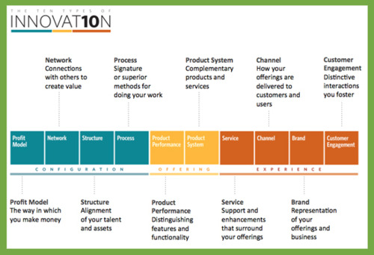
Think Types of Innovation
Ten Types of Innovation

Slide 4
Think Types of Innovation
Ten Types of Innovation
Video: https://www.youtube.com/watch?v=u_O2jJjSiCA
Discussion of Beer Industry using the Innovation Card Pak Exercise
Improving Communications through innovation…what are the “types” of the communications process where we might innovate…exercise: improving the White House communications to the press.

Slide 5
Think Design
Design Thinking
Shopping Cart video from IDEO
https://www.youtube.com/watch?v=M66ZU2PCIcM
Heilbrunn Design Thinking Process
http://www.mktgsensei.com/AMAE/Innovation%20and%20New%20Products/Product%20Developement%20Approach%20Rev5.docx
Application of design thinking to the communications process

Slide 6
Think Value
Value Proposition Canvas for Innovation
Video: https://www.youtube.com/watch?v=gB-YwlBrVVs
Pains … Gains … Tasks … applied to communications
Exercise using Value Proposition Canvas

Slide 7
Go Beyond
Concluding Remarks and Discussion
Review concepts presented
Review post workshop assignment

